Slide 1
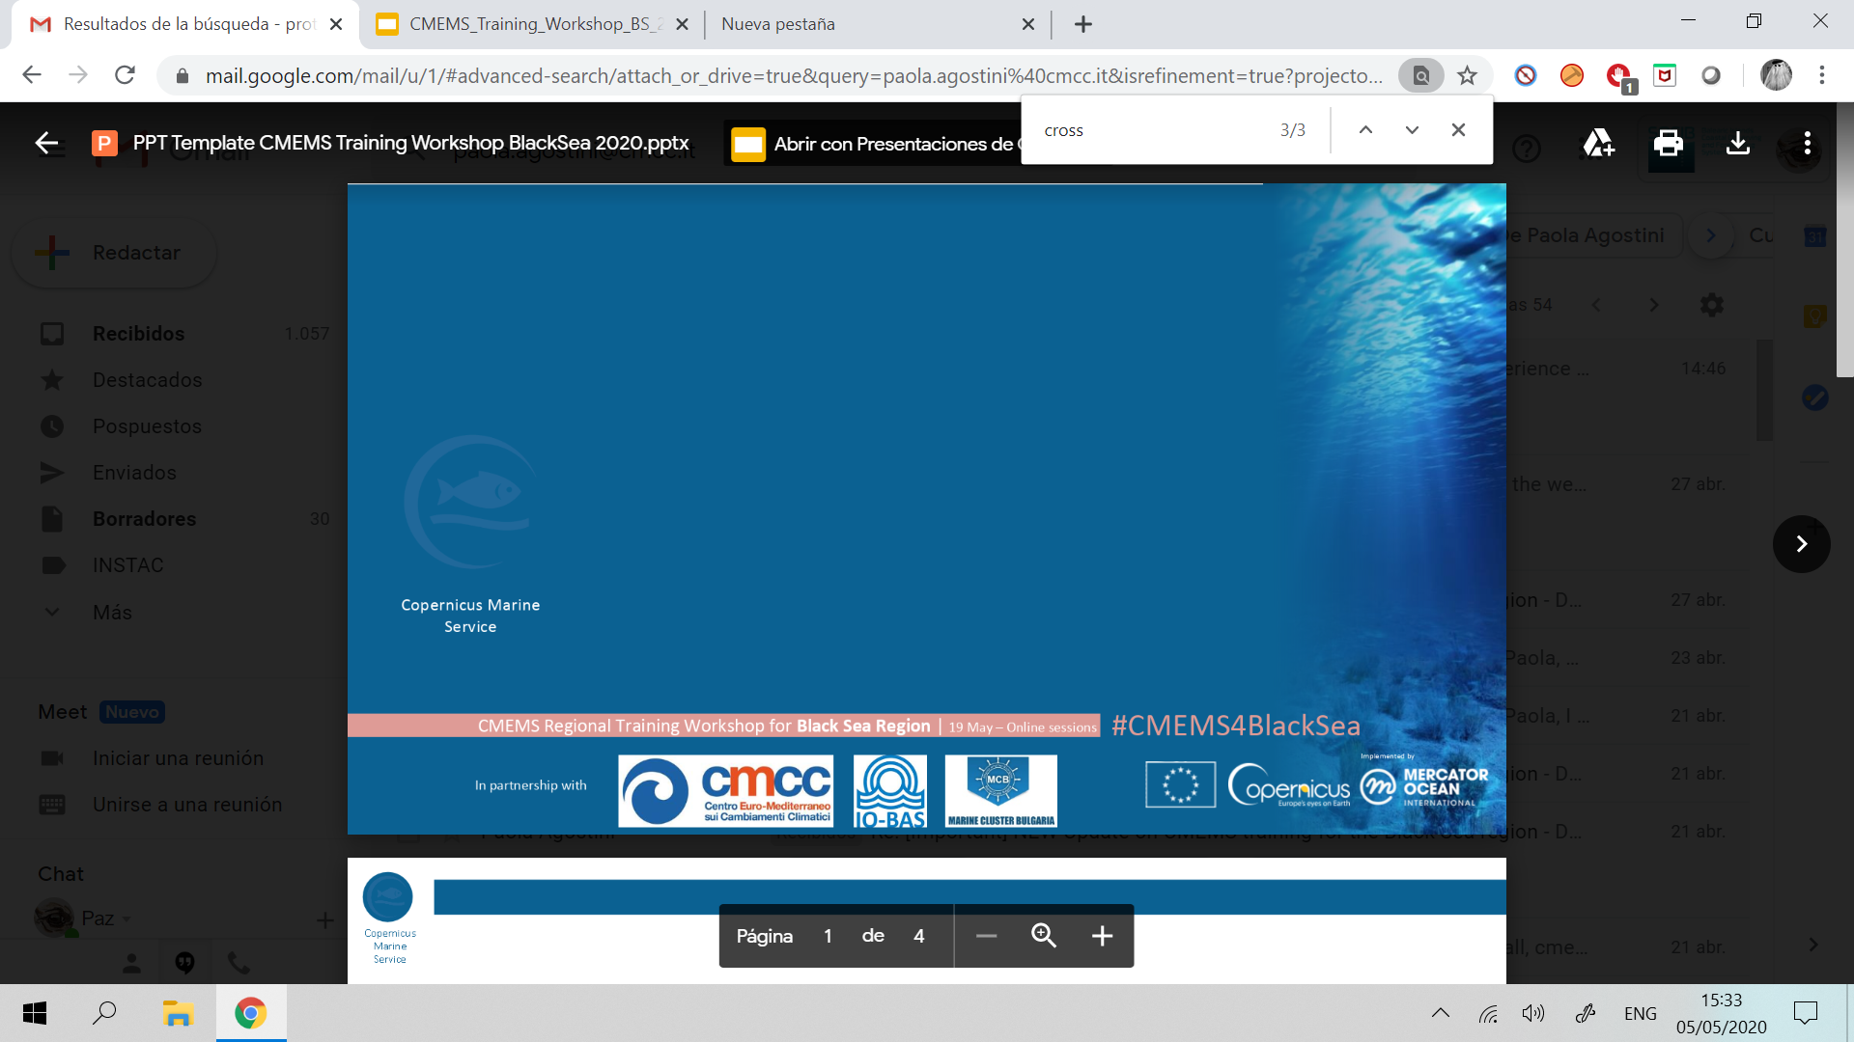




In situ products
CMEMS Regional Training Workshop for Black Sea Region | 19 May - Online session
#CMEMS4BlackSea
Black Sea Region
Veselka Marinova
Paz Rotllan

Slide 2


Index
#CMEMS4BlackSea CMEMS Regional Training Workshop for Black Sea Region | 19 May - Online session
In situ data
In Situ TAC
In Situ TAC products
In Situ TAC improvements

Slide 3
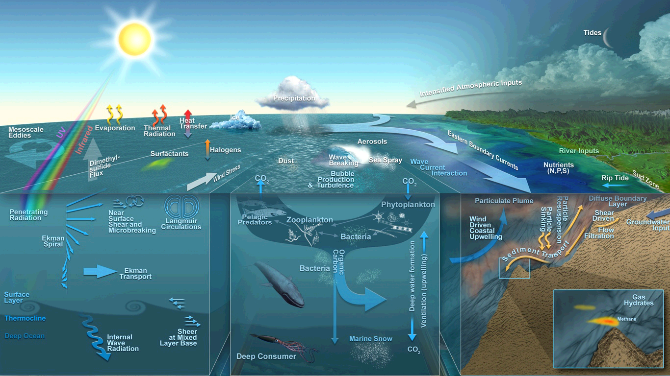
In situ data
#CMEMS4BlackSea CMEMS Regional Training Workshop for Black Sea Region | 19 May - Online session
The ocean is complex… many processes are involved.

Slide 4
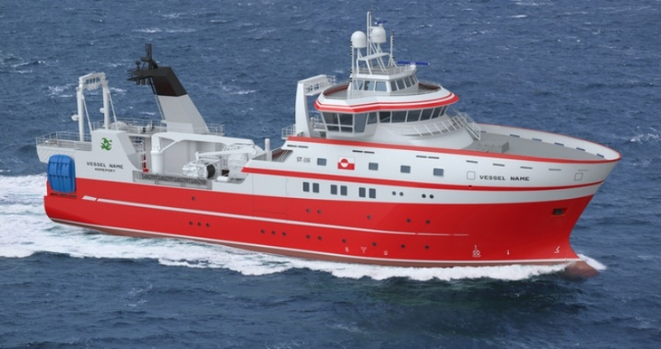
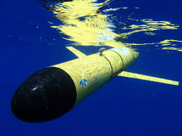
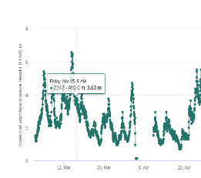
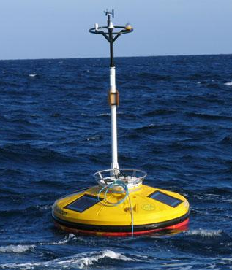
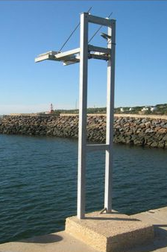
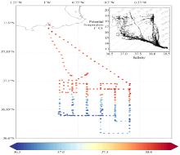
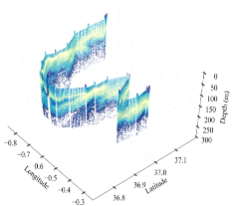
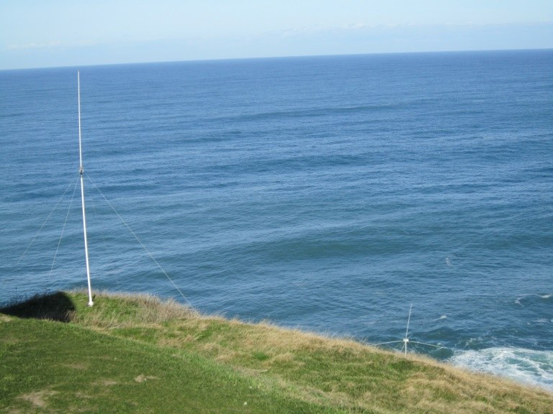
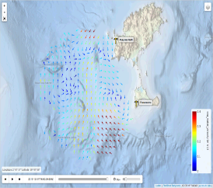
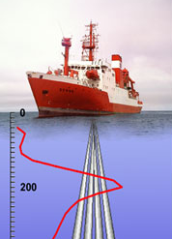
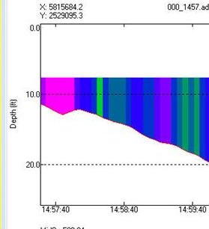
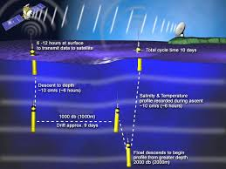
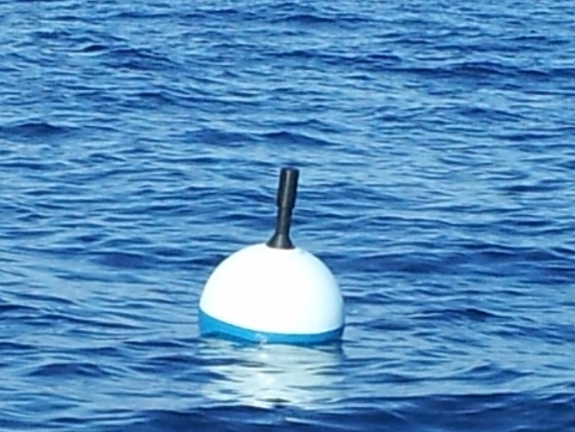
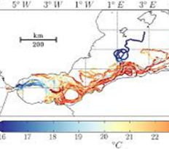
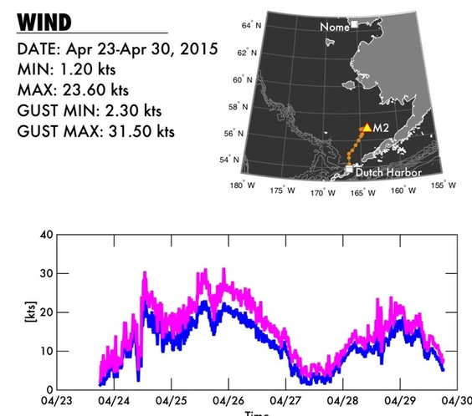
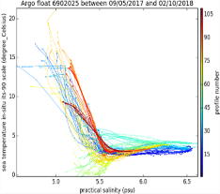
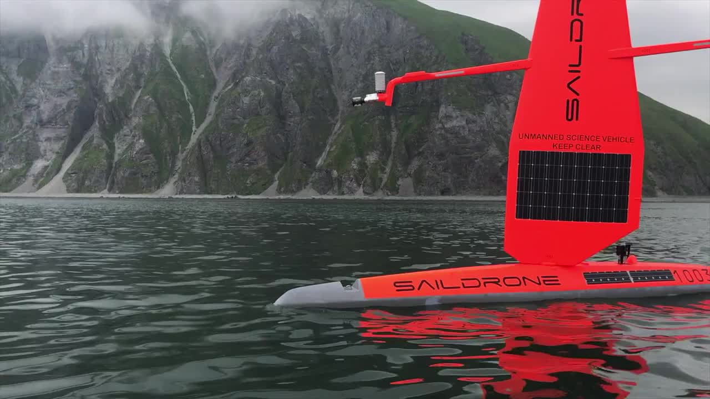
In situ data : a multi-platform approach
#CMEMS4BlackSea CMEMS Regional Training Workshop for Black Sea Region | 19 May - Online session
vessels
gliders
moorings
HF Radars
ADCP vessels
drifters
ARGO floats

Slide 5
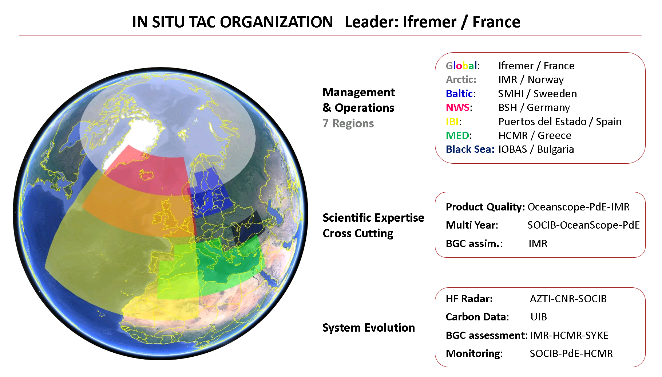

In Situ TAC : Organization
#CMEMS4BlackSea CMEMS Regional Training Workshop for Black Sea Region | 19 May - Online session

Slide 6
In Situ TAC : Main objectives
#CMEMS4BlackSea CMEMS Regional Training Workshop for Black Sea Region | 19 May - Online session
To collect multi-source, multi-platform, heterogeneous data, perform consistent quality control and distribute it in a common format (NetCDF) and in near-real-time (within 24 hours) to the CMEMS Marine Forecasting Centres (MFC), for assimilation into their numerical ocean models.
To supply the MFCs and downstream users with re-processed 25-50-year products in delayed mode. In addition to the near-real-time products, these delayed-mode products are useful for model validation or assimilation in ocean reanalysis and climate studies.

Slide 7
#CMEMS4BlackSea CMEMS Regional Training Workshop for Black Sea Region | 19 May - Online session
In Situ TAC : General description
Fully operational service since April 2015
Unique data access to all the available data: CMEMS catalogue (registration)
Open and free data policy
Strong collaboration with EuroGOOS, SeaDataNet and EMODnet
7 Components: Global + 6 regions (Arctic, Baltic, NWS, IBI, MED & Black Sea)
Same data format: New Copernicus Marine In Situ Format Manual 1.4
Same FTP structure in all the regions
Homogenization of variable names, units, attributes
Same RTQC & quality flagging convention
Two product families: REP (REProcessed) products and NRT (Near Real Time) products

Slide 8
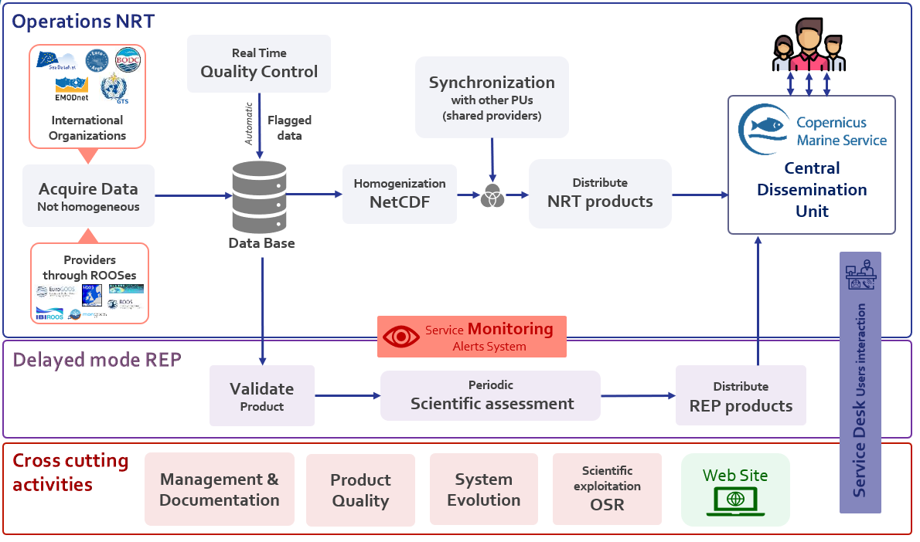
In Situ TAC : Data flow
#CMEMS4BlackSea CMEMS Regional Training Workshop for Black Sea Region | 19 May - Online session

Slide 9
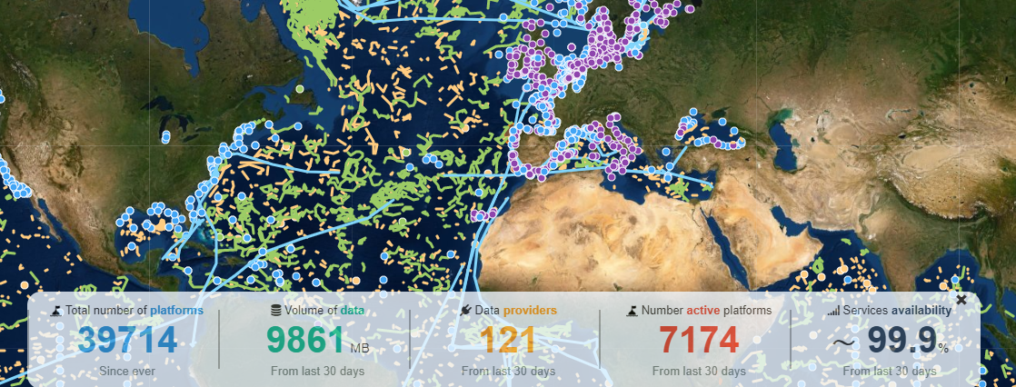
In Situ TAC : Some numbers
#CMEMS4BlackSea CMEMS Regional Training Workshop for Black Sea Region | 19 May - Online session
~7000 platforms active in Real Time
~37000 platforms integrated
~300 providers

Slide 10
In Situ TAC : Products families
#CMEMS4BlackSea CMEMS Regional Training Workshop for Black Sea Region | 19 May - Online session
Product family | REP | NRT
Update | Every 6 months | Every hour
Scope | Global | Global and regional
Quality cheks | Delayed mode | Delayed mode + Real Time (when delayed mode is not available)
Topic* | One topic (WAVE or BGC or TS or UV) | One or more topics
Example | INSITU_GLO_WAVE_REP_<code> INSITU_GLO_TS_REP_<code> INSITU_GLO_BGC_REP_<code> *MY is the new proposed acronym | INSITU_BS_NRT_<code> INSITU_GLO_UV_NRT_<code> *MYNRT is the new proposed acronym
Content | BGC: Chlorophyll and Oxygen in March 2020 UV (currents): HF radar totals since April 2019. Upcoming: Vessel-mounted ADCPs and HF radar radials in July 2020. Waves: Upcoming: Wave Spectra in Dec 2020 | T&S: Saildrones since Dec 2019 Currents: HF radar totals since April 2019 and radials since March 2020 Waves: Wave Spectra since March 2020
PUM
Product
User
Manual
Documents associated with
each product:
QuID
Quality
Information
Document
Topic: variables categories

Slide 11
In situ products : New concepts
#CMEMS4BlackSea CMEMS Regional Training Workshop for Black Sea Region | 19 May - Online session
REP products:
  Regional REP products disappeared → Only GLOBAL REP products.
  New acronym → MY
NRT products:
  Regional and global
  This product will be constantly updated with the best version of the available data in terms of quality and time coverage. In other words, it is the combination of adding NRT data when there is no REP (MY) data available.
  New acronym → MYNRT
To explain it easier, this product…

Slide 12
In situ products : Access and structure
#CMEMS4BlackSea CMEMS Regional Training Workshop for Black Sea Region | 19 May - Online session
NetCDF files are accessed from http://marine.copernicus.eu but at the end it’s only an FTP access:
  MYNRT: ftp://nrt.cmems-du.eu/Core/INSITU_BS_NRT_OBSERVATIONS_013_034/
Index files to smooth the navigation and search
Files organized based on periods:
  Latest: Last 30 days of data
  Monthly: Last 5 years of data
  History: Since ever, whole datasets

Slide 13













In situ products : Folders structure
#CMEMS4BlackSea CMEMS Regional Training Workshop for Black Sea Region | 19 May - Online session
/Core/INSITU_BS_NRT_OBSERVATIONS_013_034/
/bs_multiparameter_nrt
index_platform.txt
index_latest.txt
index_monthly.txt
index_history.txt
index_reference.txt
/latest
/monthly
/history
/reference
/YYYYMMDDD
/XX
/XX
/XX
One file / day / platform
/YYYYMMM
One file / platform
.nc
One file / platform
.nc
.nc
.nc
One file / month / platform
*Last 30 days
*Last 5 years
*Since ever
*Since ever
/XX
/PF
/GL
/MO
/RF
/HF
/DC
/TS
/CT
/XB
/BO
/ML
/FB
/SM
/SF
/DB
/TG
/SD
/VA

Slide 14
In situ products : Index of files
#CMEMS4BlackSea CMEMS Regional Training Workshop for Black Sea Region | 19 May - Online session
index_latest.txt
# Title : in situ observations catalog
# Description : catalog of available in situ observations per platform.
# Project : Copernicus
# Format version : 1.0
# Date of update : 20200505105910
#product_id,file_name,geospatial_lat_min,geospatial_lat_max,geospatial_lon_min,geospatial_lon_max,time_coverage_start,time_coverage_end,provider,date_update,data_mode,parameters
COP-BLACKSEA-01,ftp://nrt.cmems-du.eu/Core/INSITU_BS_NRT_OBSERVATIONS_013_034/bs_multiparameter_nrt/latest/20200405/BS_TS_MO_15360_20200405.nc,45.15,45.15,29.67,29.67,2020-04-05T06:00:00Z,2020-04-05T18:00:00Z,NOAA / National Geophysical Data Center (NOAA/NGDC),2020-05-05T10:51:34Z,R,DEPH TEMP VGHS VGTA
COP-BLACKSEA-01,ftp://nrt.cmems-du.eu/Core/INSITU_BS_NRT_OBSERVATIONS_013_034/bs_multiparameter_nrt/latest/20200405/BS_TS_MO_15428_20200405.nc,44.68,44.68,28.98,28.98,2020-04-05T12:00:00Z,2020-04-05T12:00:00Z,NOAA / National Geophysical Data Center (NOAA/NGDC),2020-05-05T10:51:34Z,R,DEPH TEMP VGHS VGTA
COP-BLACKSEA-01,ftp://nrt.cmems-du.eu/Core/INSITU_BS_NRT_OBSERVATIONS_013_034/bs_multiparameter_nrt/latest/20200405/BS_TS_MO_15480_20200405.nc,44.22,44.22,28.63,28.63,2020-04-05T06:00:00Z,2020-04-05T18:00:00Z,NOAA / National Geophysical Data Center (NOAA/NGDC),2020-05-05T10:51:35Z,R,DEPH TEMP VGHS VGTA

Slide 15
In situ products : Index of platforms
#CMEMS4BlackSea CMEMS Regional Training Workshop for Black Sea Region | 19 May - Online session
index_platform.txt
# Title : in situ observations catalog
# Title : in situ observations catalog
# Description : catalog of available in situ observations per platform.
# Project : Copernicus
# Format version : 1.0
# Date of update : 20200505110112
#platform_code,creation_date,update_date,wmo_platform_code,data_source,institution,institution_edmo_code,parameters,last_latitude_observation,last_longitude_observation,last_date_observation
15360,2020-05-05T10:56:45Z,2020-05-05T10:56:45Z,15360,BS_TS_MO_15360_YYYYMMDD,NOAA / National Geophysical Data Center (NOAA/NGDC),1978,DEPH TEMP VGHS VGTA,45.15,29.67,2020-05-05T06:00:00Z
15428,2020-05-05T10:56:37Z,2020-05-05T10:56:37Z,15428,BS_TS_MO_15428_YYYYMMDD,NOAA / National Geophysical Data Center (NOAA/NGDC),1978,DEPH TEMP VGHS VGTA,44.68,28.98,2020-05-04T18:00:00Z
15480,2020-05-05T10:56:45Z,2020-05-05T10:56:45Z,15480,BS_TS_MO_15480_YYYYMMDD,NOAA / National Geophysical Data Center (NOAA/NGDC),1978,DEPH TEMP VGHS VGTA,44.22,28.63,2020-05-05T06:00:00Z

Slide 16
In situ products : File naming
#CMEMS4BlackSea CMEMS Regional Training Workshop for Black Sea Region | 19 May - Online session
Region bigram
GL Global
AR Arctic
BO Baltic
NO North West Shelf
IR Iberia-Biscay-Ireland
MO Mediterranean
BS Black Sea
File type
TS Time series
PR Profile
TV Total velocities (HF Radars)
RV Radial velocities (HF Radars)
WS Wave spectral data
Data types
PF profiling floats
GL gliders
MO fixed buoys, mooring time series
RF River flow
HF HF radar
DB drifting buoys
DC drifting buoy reporting current
CT oceanographic CTD profiles
BO bottle data
FB ferrybox
SF towed CTD data (ex: scanfish)
TG Tide gauge station
TS thermosalinograph data
XB XBT or XCTD profiles
ML mini logger for fishery observing system
SM Sea mammals data
XX Not yet identified data type
SD Saildrones
VA Vessel mounted ADCPs
Latest directory:
RR_XX_YY_CODE_YYYYMMDD.nc
Monthly directory:
RR_XX_YY_CODE _YYYYMM.nc
History directory:
RR_XX_YY_CODE_ZZZ.nc
RR: region bigram
XX: file type
YY: data type
CODE: platform code
YYYYMMDD: year month day of observations
YYYYMM : year month of observations
ZZZ : only if different time samplings
.nc: NetCDF file name suffix

Slide 17
In situ products : New format manual doc
#CMEMS4BlackSea CMEMS Regional Training Workshop for Black Sea Region | 19 May - Online session
Most important changes
  Agreement in use of global attributes
  All global attributes are mandatory (some of them accept empty string)
  Coordinate variables: Z may be non monotonic
  Coordinate variables: Position dimension may be 1 for fixed platforms
  Coordinate variables: No fill_value attribute for time, latitude and longitude
  Agreement on data mode management (global, variable and value levels)
  HF radar chapter: Conventions for HF radar data
  Wave spectra chapter: Convention for wave spectral data

Slide 18
In situ products : Further info
#CMEMS4BlackSea CMEMS Regional Training Workshop for Black Sea Region | 19 May - Online session
Names are going to change (Dec 2020):
Products
INSITU_BS_NRT_OBSERVATIONS_013_034 → INSITU_BLK_PHYBGCWAV_3D_MYNRT_013_034
Datasets
blk_multiparameter_nrt → cmems_obs-ins_blk_phybgcwav_mynrt_na_na

Slide 19
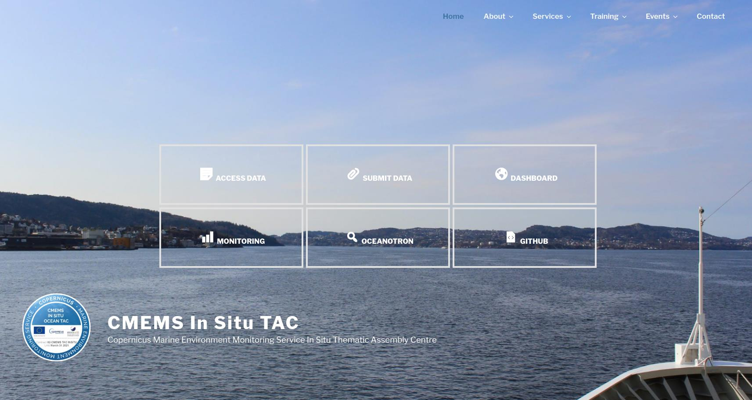
http://www.marineinsitu.eu

Slide 20
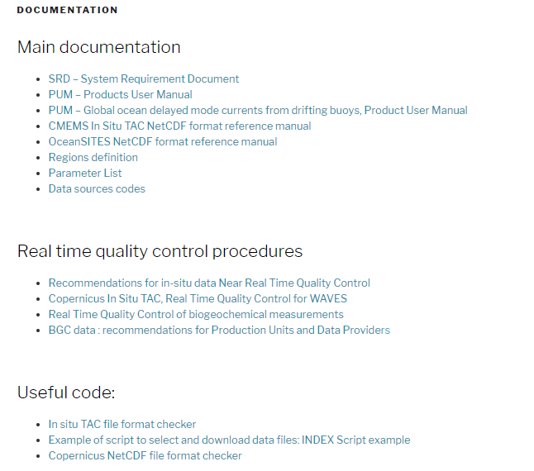
In Situ TAC improvements : web site
#CMEMS4BlackSea CMEMS Regional Training Workshop for Black Sea Region | 19 May - Online session
> About > Documentation
http://www.marineinsitu.eu/documentation/
Documentation
SRD – System Requirement Document
PUM – Products User Manual
NetCDF Format Manual
Parameters List
Quality Control procedures
Some useful code

Slide 21
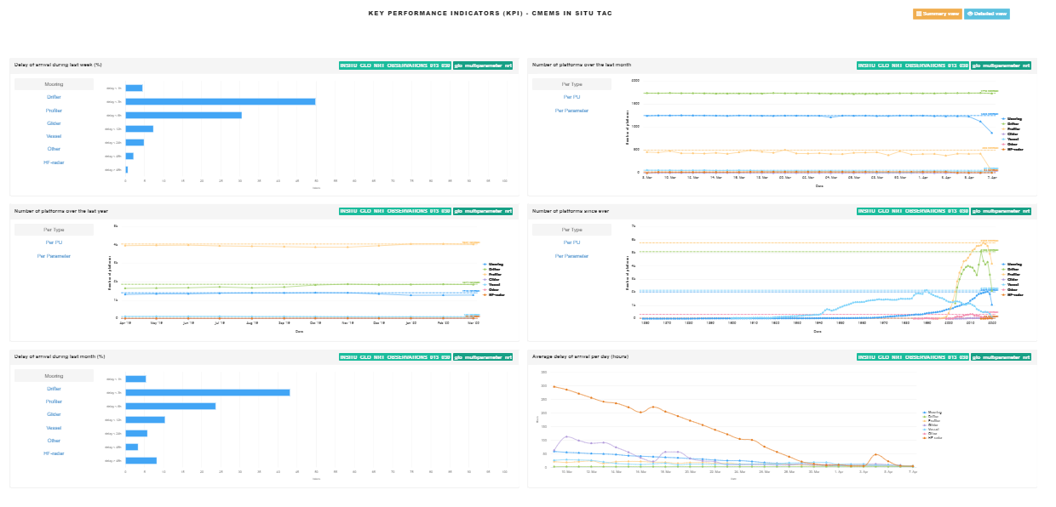
In Situ TAC improvements : KPIs
#CMEMS4BlackSea CMEMS Regional Training Workshop for Black Sea Region | 19 May - Online session
> Services > Monitoring
http://www.marineinsitu.eu/monitoring/
Key Performance Indicators
KPI1 – Delay of Arrival
KPI2 – Number of Platforms
KPI3 – Data Quality
KPI4 – Usage (deprecated)
KPI5 – Data Providers
KPI6 – Data Files

Slide 22
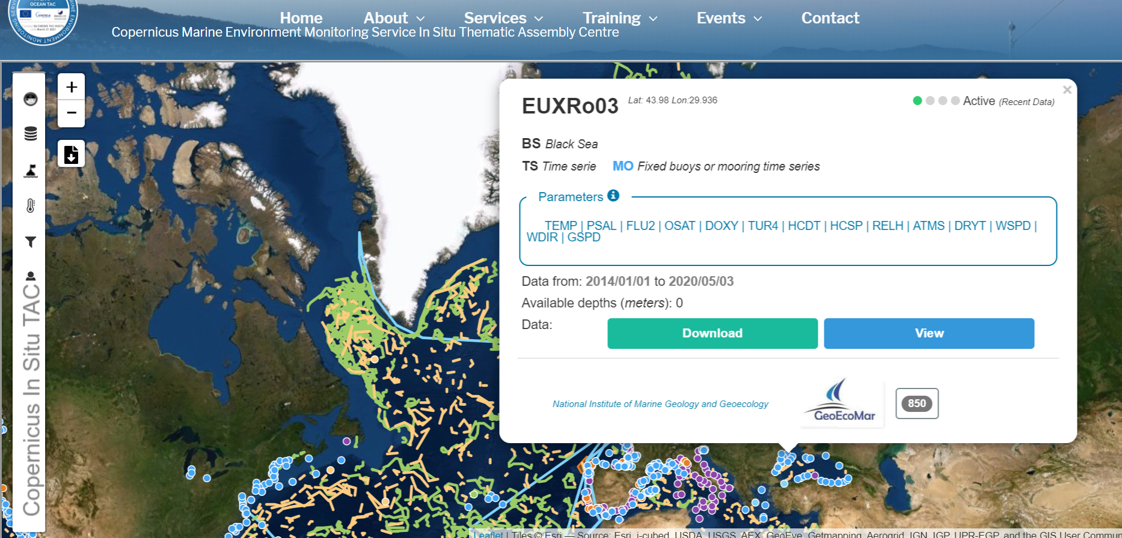
In Situ TAC improvements : Dashboard
#CMEMS4BlackSea CMEMS Regional Training Workshop for Black Sea Region | 19 May - Online session
> Services > Dashboard http://www.marineinsitu.eu/dashboard/

Slide 23
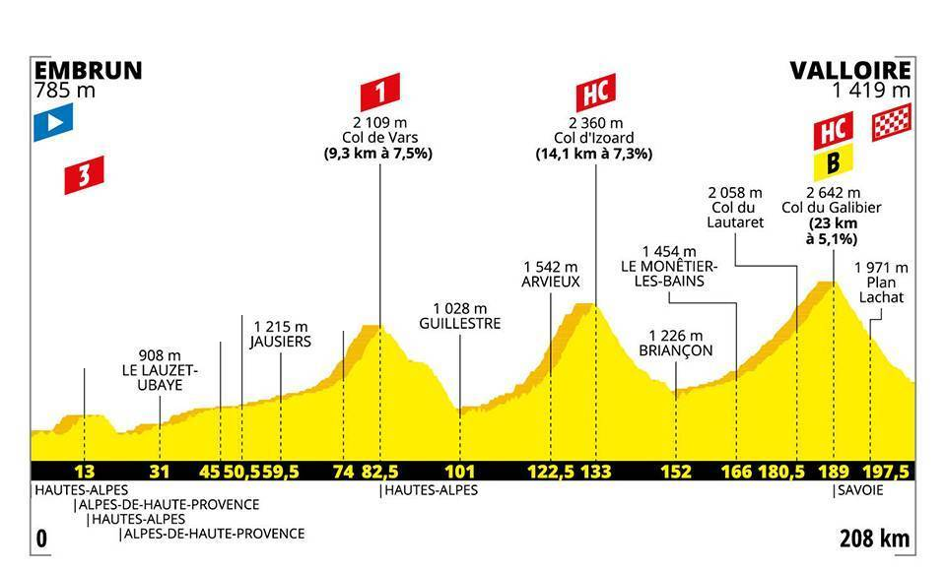

In Situ TAC improvements : Added value
#CMEMS4BlackSea CMEMS Regional Training Workshop for Black Sea Region | 19 May - Online session
Extra functions and cross-cutting services
Feedback to providers
Data quality: Best added-value feature
Data gathering and format homogenization: Basic service
CMEMS In Situ TAC never stops!

Slide 24
CMEMS Regional Training Workshop for Black Sea Region | 19 May - Online session
#CMEMS4BlackSea

